Slide 1
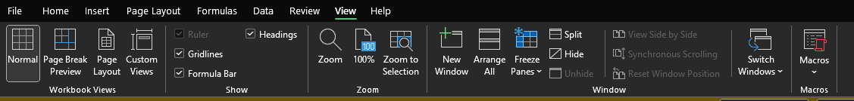
Introduction to Excel's View Section
Purpose of the View Section: - Customizes how data is displayed in Excel. - Provides various tools to enhance data visibility and management.
Importance in Data Management: - Facilitates better data analysis. - Helps in preparing data for presentation and printing.

Slide 2
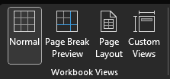

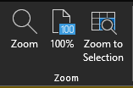
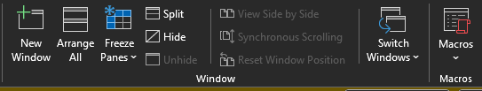
Navigating the View Tab
Locating the View Tab: - Found in the top menu bar of Excel. - Contains various tools for customizing the worksheet view.
Key Features: - Workbook Views: Normal, Page Layout, Page Break Preview. - Show: Ruler, Gridlines, Formula Bar, Headings. - Zoom: Zoom in/out, 100%, Selection. - Window: New Window, Arrange All, Split, Freeze Panes.

Slide 3
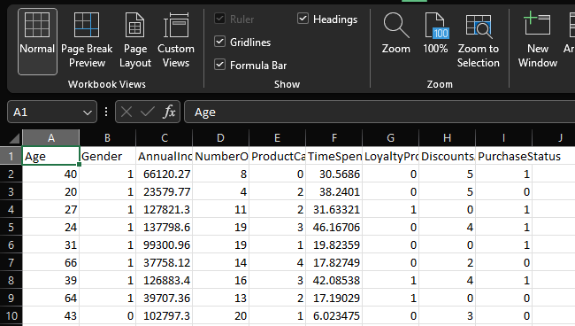
Normal View
Description: - Default view for entering and editing data. - Provides a straightforward grid layout.
Benefits: - Simplifies data entry and editing. - Clear view of the worksheet grid.

Slide 4
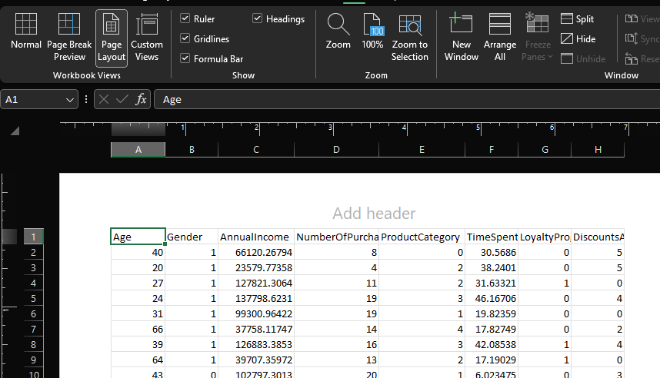
Page Layout View
Description: - Mimics the appearance of a printed page. - Useful for preparing documents for printing and adding headers/footers.
Benefits: - Provides a visual representation of how the document will print. - Facilitates adjustments to margins, headers, and footers.

Slide 5
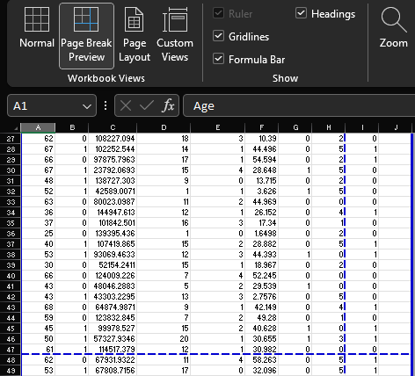
Page Break Preview
Description: - Shows where pages will break when printed. - Allows adjustment of page breaks for optimal printing layout.
Benefits: - Ensures that data is printed in a coherent manner. - Helps in managing large datasets across multiple pages.

Slide 6
Custom Views
Creating a Custom View: - Set up your worksheet with the desired display settings. - Go to 'View' tab > 'Custom Views' > 'Add' to save the current view.
Using Custom Views: - Switch between saved views by selecting them from the 'Custom Views' menu. - Saves time by allowing quick access to preferred display settings.
Applications: - Educational: Quickly switch between different layouts for assignments and projects. - Professional: Efficiently manage different views for reports, presentations, and meetings.

Slide 7

Freezing Panes
Description: - Freezes selected rows and columns to keep them visible while scrolling. - Go to 'View' tab > 'Freeze Panes' to select rows/columns to freeze.
Benefits: - Keeps headers or important data in view at all times. - Useful for large datasets to maintain context.
Photo by Luke Chesser on Unsplash

Slide 8

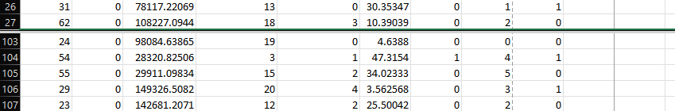
Splitting Windows
Description: - Splits the worksheet into multiple panes to view different sections simultaneously. - Go to 'View' tab > 'Split' to divide the window.
Benefits: - Useful for comparing data across different parts of the worksheet. - Enhances productivity by reducing the need to scroll.

Slide 9

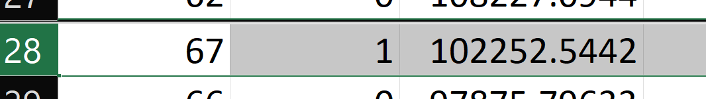
Using Zoom Options
Description: - Adjusts the zoom level of the worksheet for better visibility. - Go to 'View' tab > 'Zoom' to set the desired zoom level.
Benefits: - Enhances readability of data. - Useful for focusing on specific parts of the worksheet.

